Slide 1

Chapter 8: AI Legislations and POLICIES

Slide 2
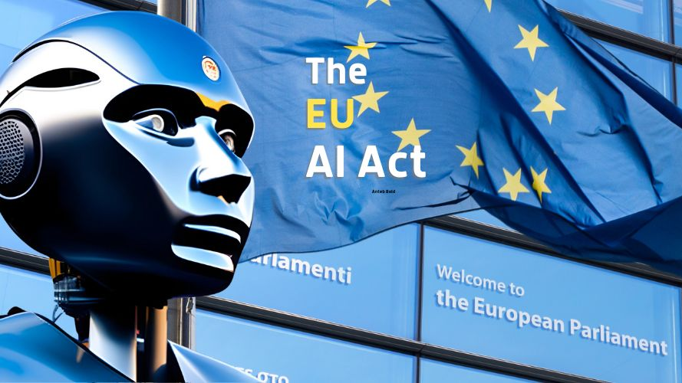
European Union’s AI Act

Slide 3

European Union’s AI Act
It is the world’s first comprehensive law specifically regulating artificial intelligence.
Finalized in 2024 and will be fully implemented by 2026, it aims to ensure that AI systems used in Europe are safe, respect fundamental rights, and promote trust in AI technologies.

Slide 4

EU AI Act in a Nutshell
Unlike the GDPR, the AI Act takes a risk-based approach regarding AI Systems and classifies them into four categories:
Unacceptable risk: AI systems that are prohibited from public use, e.g., social scoring by governments)
High risk: AI systems that require strict rules and oversight, e.g., AI in hiring, credit scoring, healthcare
Limited risk: AI systems that require transparency obligations, e.g. chatbots must disclose they’re AI
Minimal risk: AI systems that do not have any direct or indirect risk to harm humans, e.g. AI in video games, spam filters

Slide 5

Prohibited AI Systems (Article 5)
Subliminal Manipulation
AI systems that deploy subliminal techniques beyond a person's consciousness or purposefully use manipulative or deceptive techniques that materially distort behavior, impair decision-making, and cause or are likely to cause significant harm.
Exploitation of Vulnerabilities
AI systems that exploit vulnerabilities of specific groups (e.g., age, disability, social/economic situation) in a manner that causes or is likely to cause harm.

Slide 6
Prohibited AI Systems (Article 5)
3. Social Scoring
AI systems that evaluate or classify individuals or groups based on social behavior or personal traits, leading to detrimental or unfavorable treatment unrelated to the context in which the data was collected.
4. Predictive Policing
AI systems that assess or predict the risk of individuals committing a criminal offense solely based on profiling or personality traits, unless used to support human assessments based on objective and verifiable facts directly related to criminal activity.

Slide 7
Prohibited AI Systems (Article 5)
5. Untargeted Facial Recognition Data Scraping
AI systems that create or expand facial recognition databases through the untargeted scraping of facial images from the internet or CCTV footage.
6. Emotion Recognition in Workplace and Educational Settings
AI systems that infer emotions of individuals in workplaces or educational institutions, except when used for medical or safety reasons.

Slide 8
Prohibited AI Systems (Article 5)
7. Biometric Categorization
AI systems that categorize individuals based on biometric data to deduce or infer attributes like race, political opinions, or sexual orientation, except when used for labeling or filtering lawfully acquired biometric datasets by law enforcement agencies.
8. Real-Time Remote Biometric Identification in Public Spaces by Law Enforcement
AI systems for real-time remote biometric identification in public spaces for law enforcement purposes, unless necessary for specific objectives such as searching for victims of abduction or preventing imminent terrorist attacks, and subject to strict safeguards and prior authorization.

Slide 9

Specific High-Risk Use Cases
The EU AI Act deems some AI Applications as high-risk due to their potential impact on fundamental rights. These include AI systems used in:
Biometric Identification and Categorization: AI emotion detection in interviews.
Critical Infrastructure Management: AI-based rail traffic management

Slide 10
Specific High-Risk Use Cases
Education and Vocational Training: AI grading systems for exams
Employment and Worker Management: Automated resume screening AI
Access to Essential Private and Public services: AI systems for social welfare eligibility

Slide 11
Specific High-Risk Use Cases
Law Enforcement: Automated forensic analysis AI
Migration, Asylum, and Border Control: AI lie detection at borders
Administration of Justice and Democratic Processes: E-voting fraud detection AI

Slide 12

AI Risk Management (Article 9)
Article 9 mandates that providers of high-risk AI systems establish, implement, document, and maintain a risk management system throughout the AI system's lifecycle. This system should be a continuous, iterative process aimed at ensuring the AI system's compliance with the Act's requirements and safeguarding fundamental rights.​

Slide 13
AI Risk Management (Article 9)
Risk Identification and Analysis: Identify and analyze known and reasonably foreseeable risks to health, safety, and fundamental rights that may arise when the AI system is used as intended or under reasonably foreseeable misuse.​
Risk Evaluation and Assessment: Estimate and evaluate the risks identified, considering their severity and probability, to determine if they are acceptable or require mitigation.​

Slide 14
AI Risk Management (Article 9)
Risk Mitigation Measures: Implement appropriate measures to eliminate or reduce risks as far as possible through design and development.
For residual risks, apply adequate mitigation and control measures.
Provide deployers with necessary information and training to mitigate risks, considering their technical expertise and the intended use of the AI system.​

Slide 15
AI Risk Management (Article 9)
Testing and Validation: Test the AI system to identify effective and targeted risk management measures.
Ensure consistent performance and compliance with the Act's requirements, which may include testing in real-world conditions.​
Continuous Monitoring and Updating: Regularly review and update the risk management system based on new information, including data from post-market monitoring and feedback from deployers.

Slide 16

Bahrain’s General Policy for the Use of AI
First published in July 2025 by the Bahraini Information and eGovernment Authority.
The main objectives of the Policy are to:
Build a national AI framework with ethical and legal safeguards
To improve government efficiency and service delivery using AI
To encourage innovation, research, and skills development to position Bahrain as a regional leader in AI
To ensure that AI contributes to sustainability and protects Bahrain’s culture and identity

Slide 17
Guiding Principles
The policy sets out 11 guiding principles:
Human decision-making – AI assists but final authority stays with humans.
Safety & prevention of harm – Protect individuals from physical/psychological harm.
Fairness & non-discrimination – Ensure AI is unbiased and equitable.
Transparency & explainability – AI must be understandable and accountable.
Responsibility & accountability – Clear roles for errors or misuse.

Slide 18
Guiding Principles
Integrity – Data must be accurate, not falsified.
Privacy & data protection – Safeguard personal information.
Reliability & security – AI must be trustworthy and resilient.
Investment in advanced technology – Encourage continuous innovation.
Promoting innovation – Use AI for sustainable transformation.
Intellectual property protection – Safeguard AI innovations and rights

Slide 19
Four Policy Pillars
Commitment to Policies & Legislation
Compliance with Bahrain’s laws (Data Protection Law 2018, Cybercrime Law 2014, Cloud Computing Law 2018, etc.)
Protect state documents, data privacy, and security
Use & Adoption of AI
Apply AI across government sectors (health, education, transport, etc.).
Ensure human oversight and audits of AI systems.
Responsibility lies with people, not machines

Slide 20
Four Policy Pillars
Awareness & Education
Train government employees on AI applications and ethics.
Promote continuous learning and AI literacy
Local & International Cooperation
Collaborate with the private sector, GCC, and global partners.
Encourage participation in AI conferences, workshops, and research projects

Slide 21
Discussion 8.1: what would you add/remove in Bahrain’s general policy for ai Version 2.0?

Slide 22
Summary
The EU AI Act is the world’s first comprehensive AI law using a risk-based model (unacceptable, high, limited, minimal risk).
Certain AI uses are prohibited, including social scoring, manipulative systems, and untargeted facial recognition scraping.
High-risk AI must follow strict risk management obligations across its lifecycle (Article 9).
Bahrain’s AI Policy promotes human oversight, fairness, transparency, accountability, and innovation.
AI governance is shifting from voluntary ethics to binding legal compliance.
Critical Reflection
Can innovation thrive under strict regulation?
Should all countries adopt a risk-based AI law like the EU?

